Slide 1
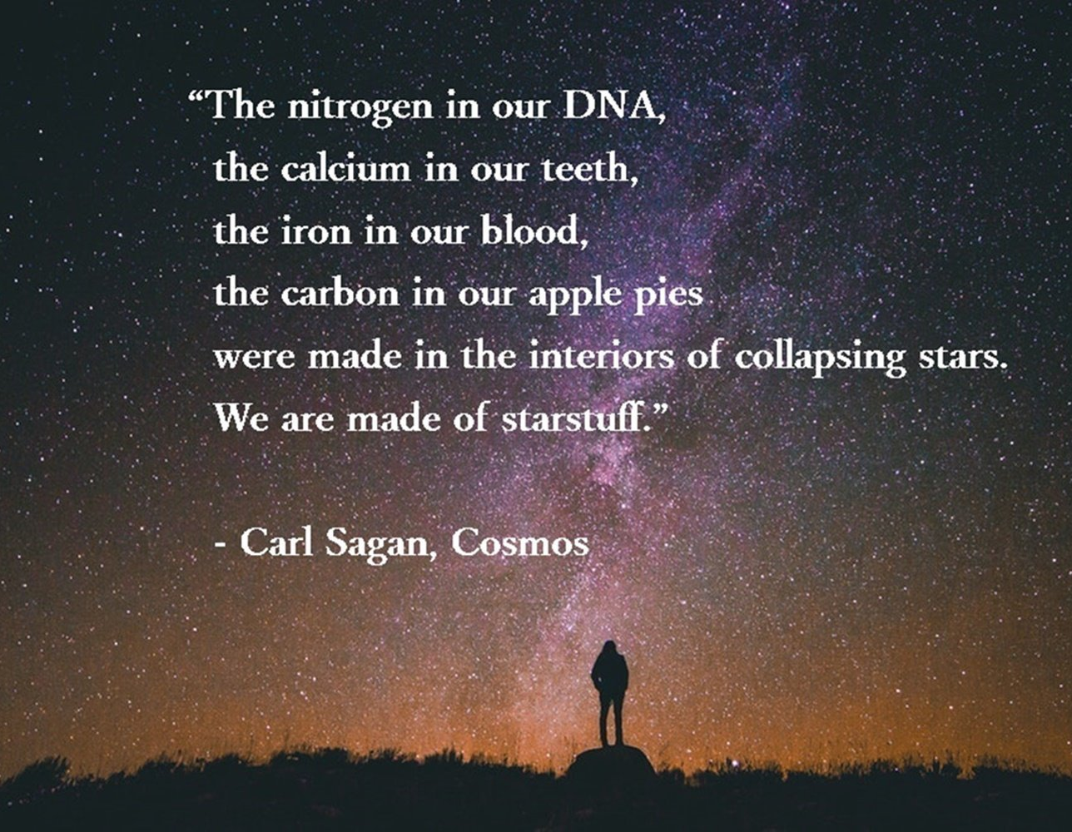
Bio-molecules and Bio-polymers:
The stuff that we are made of

Slide 2
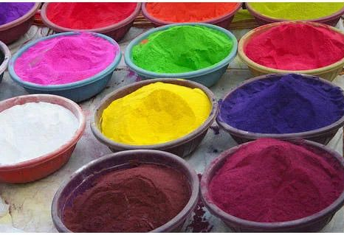

Slide 3



Slide 4


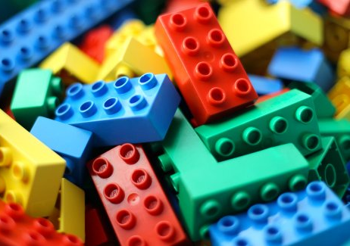

Slide 6
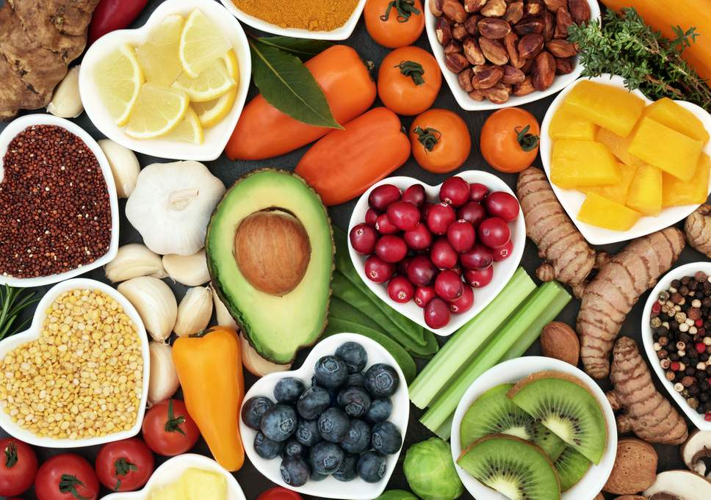
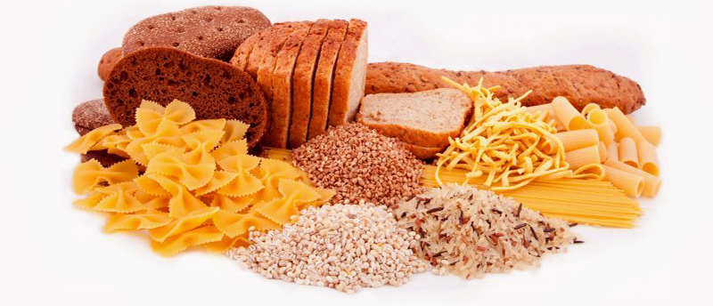
Carbohydrates

Slide 7
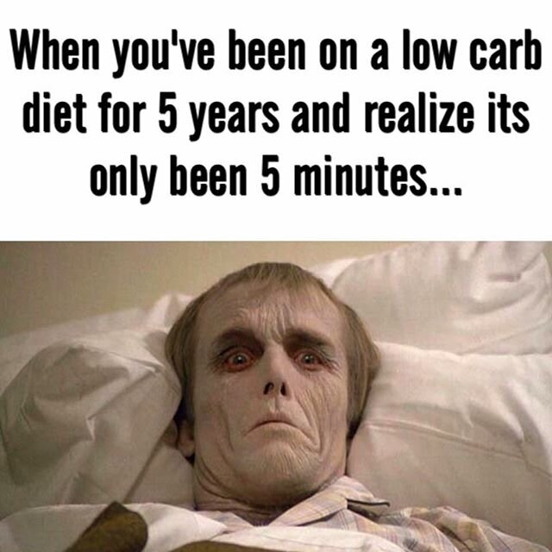
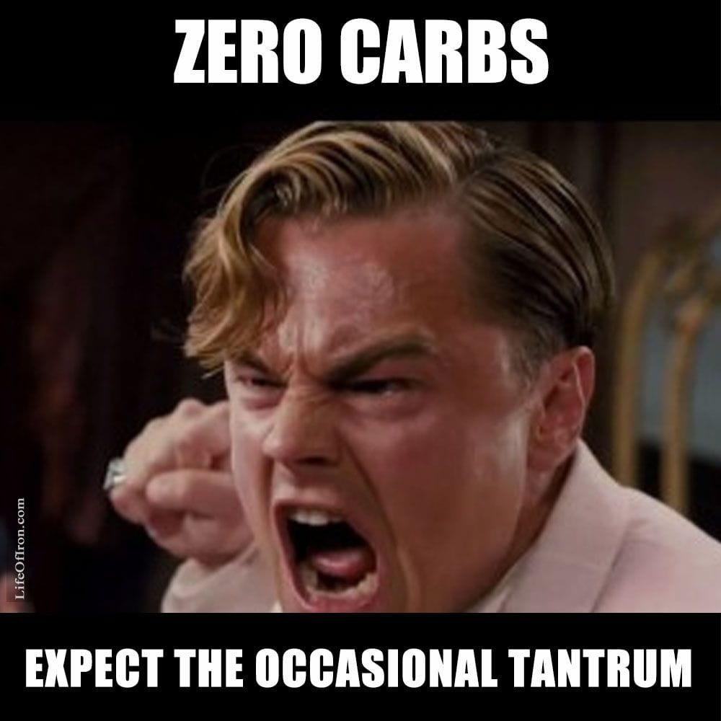

Slide 8
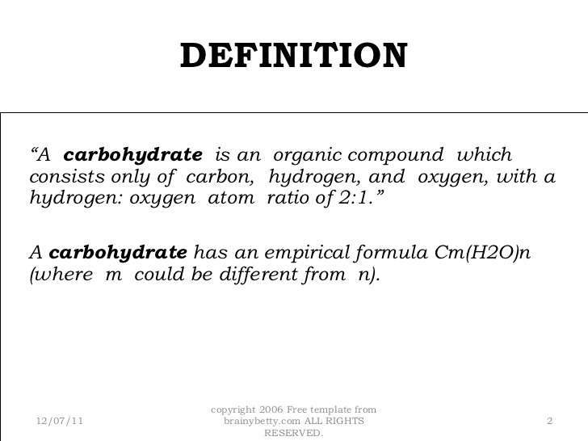
Carbohydrates

Slide 9

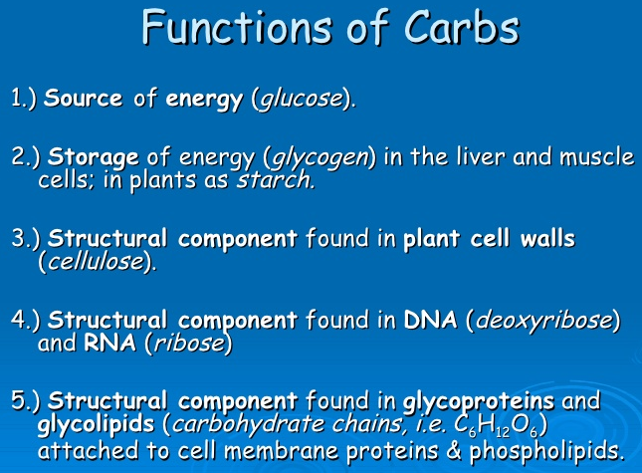
Carbohydrates

Slide 10
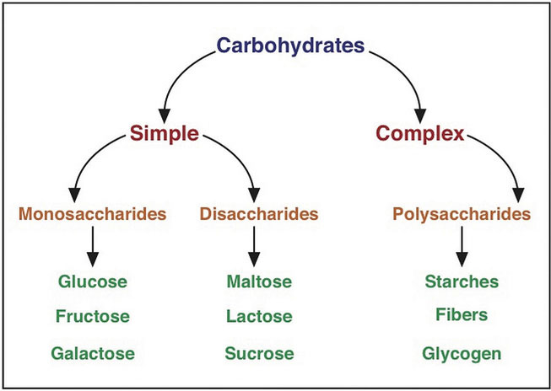
Carbohydrates-classification

Slide 11
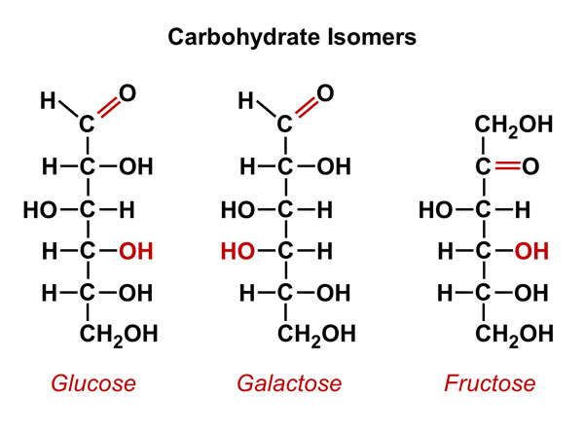
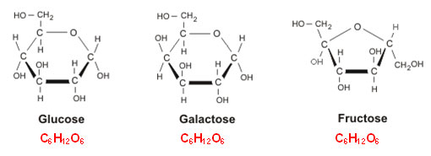
Carbohydrates-Monosaccharides

Slide 12
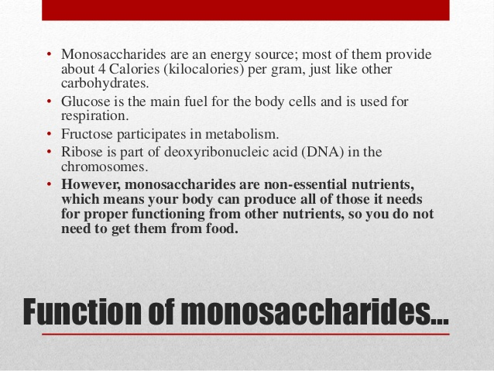
Carbohydrates-Monosaccharides

Slide 13
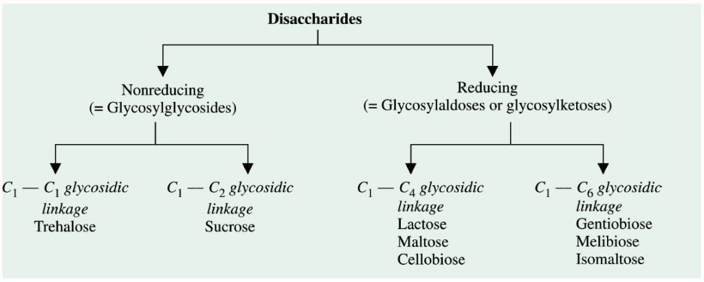
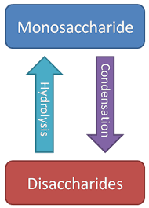
Carbohydrates-Disaccharides

Slide 14
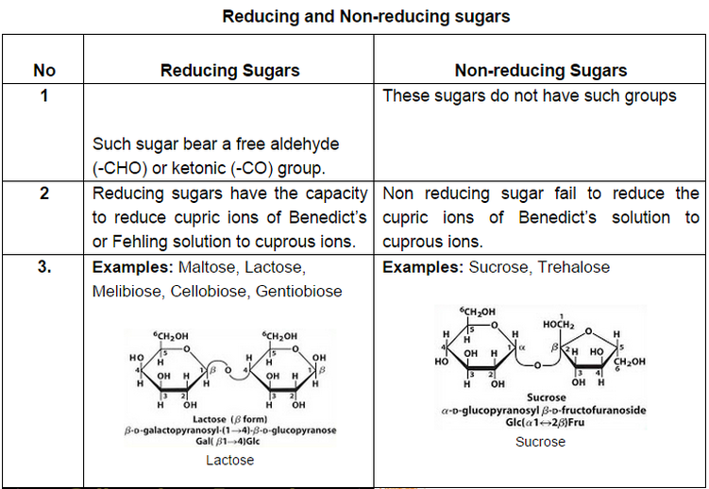
Carbohydrates-Disaccharides

Slide 15
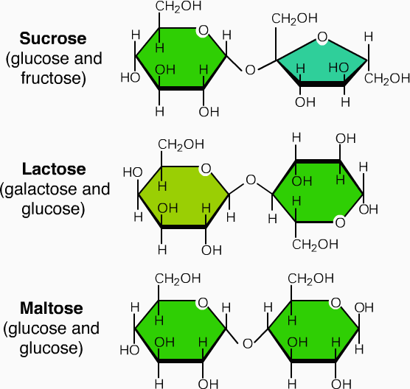
Carbohydrates-Disaccharides

Slide 16
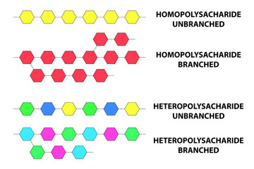
Carbohydrates-Polysaccharides classification

Slide 17
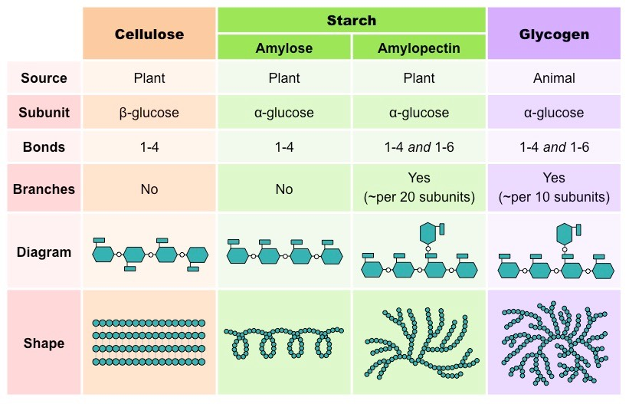
Carbohydrates-homopolysaccharides

Slide 18
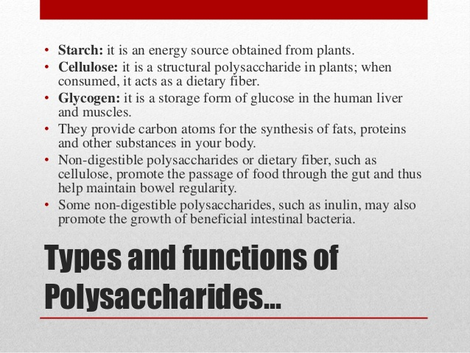

Slide 19
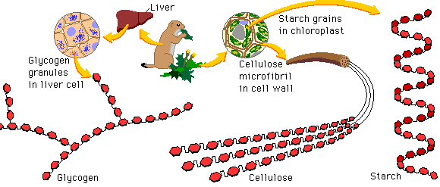
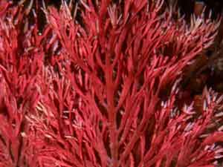
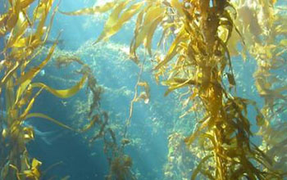
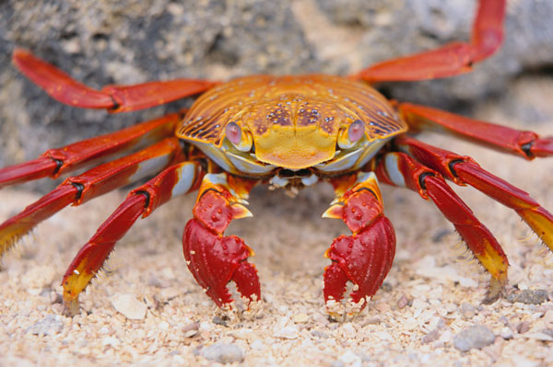
Carbohydrates-Polysaccharides
Marine polysaccharides
Carragenan
Fucoidan
Chitin

Slide 20
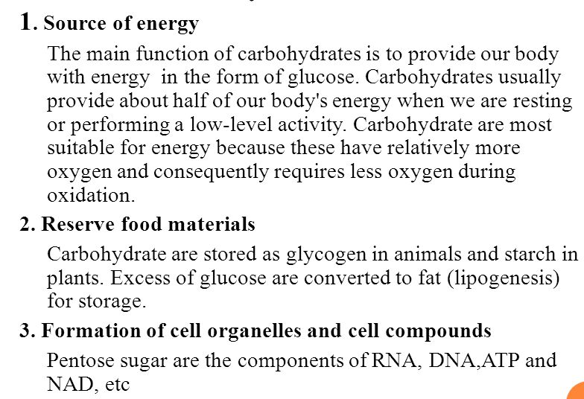
Biological importance of carbohydrates

Slide 21
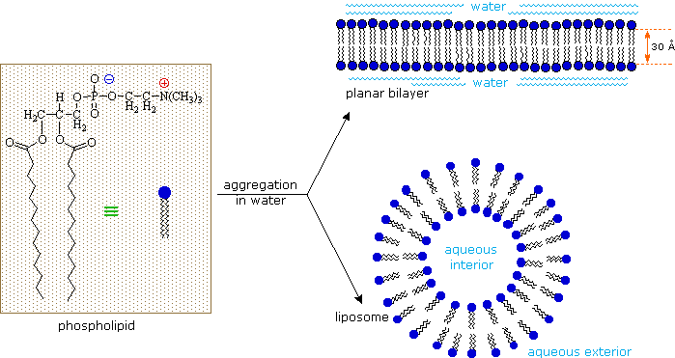
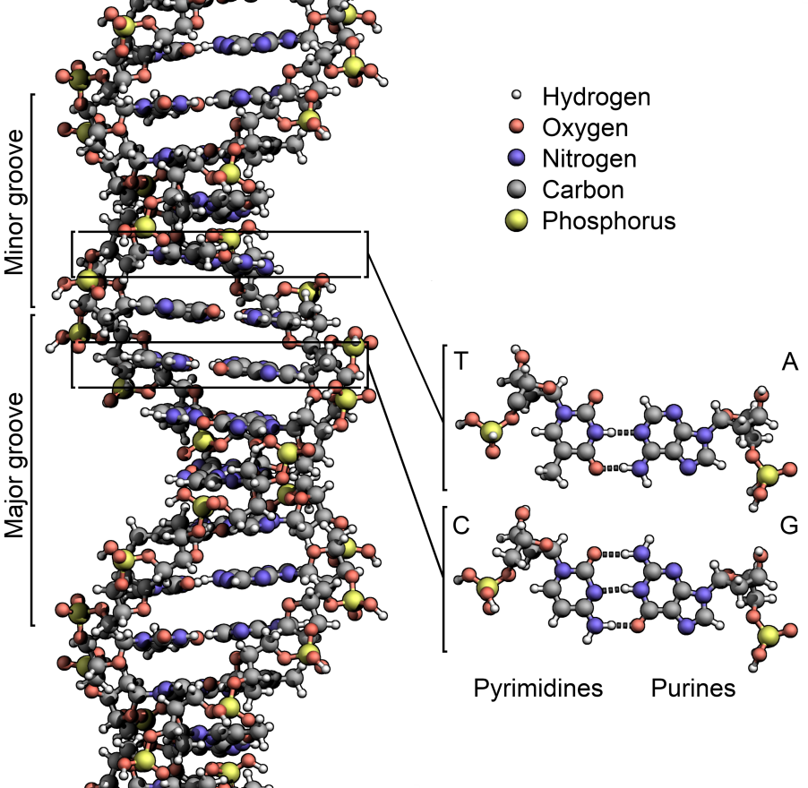
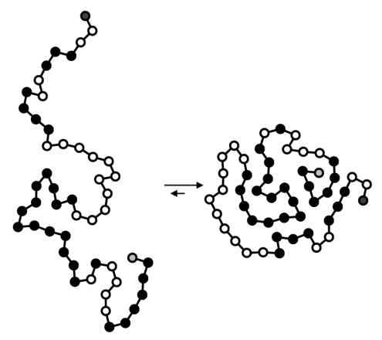
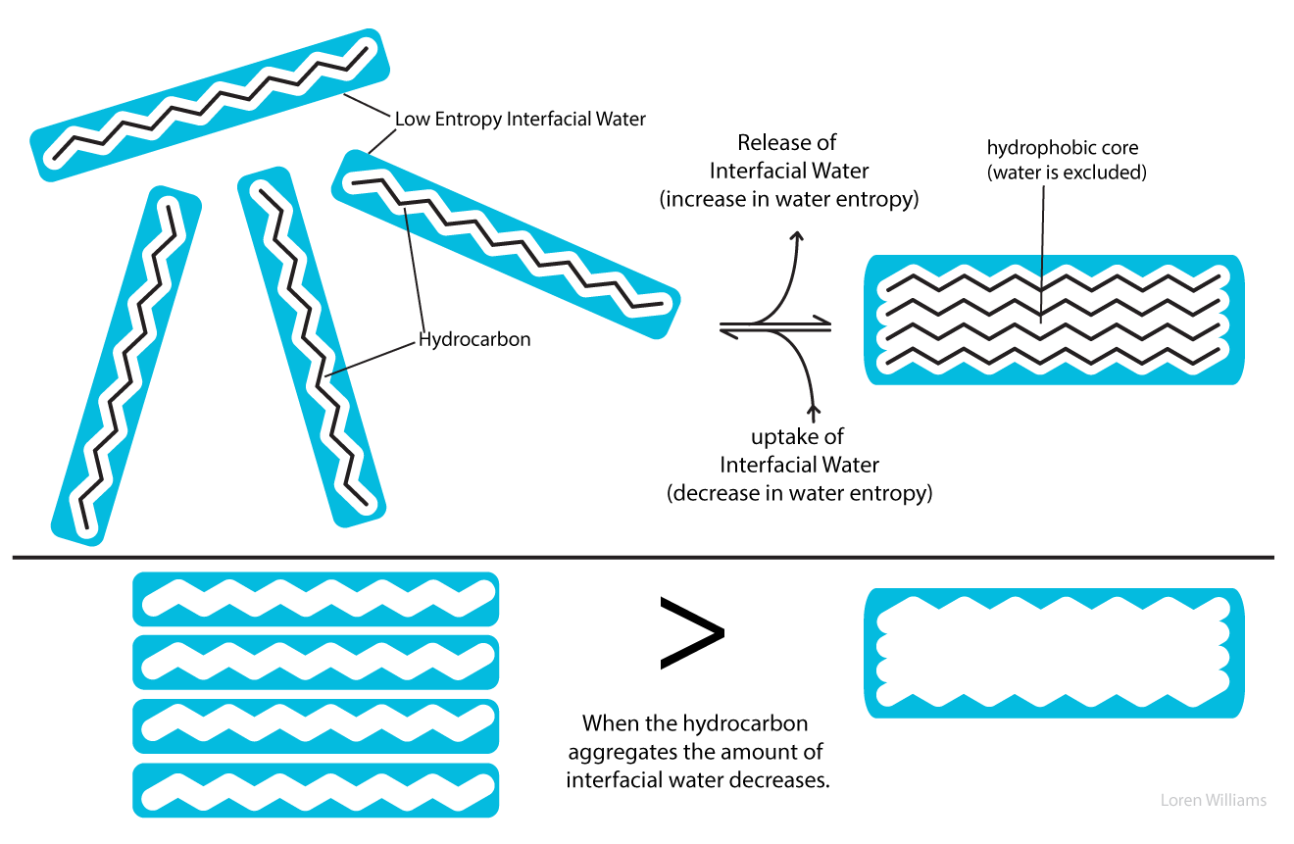
Interaction of water with other biomolecules
Organization of lipids in water
Organization of Nucleic acid in water
Organization of proteins in water

Slide 22
References:
1. Nelson And Cox, Lehninger Principles of Biochemistry, 6th edition
2. Springer- Advances in biochemical engineering in Biotechnology, Scheper, Plant Cells.
3. Bioinformatics: Joel Keizer
4. Images: Search engine Google.
5. Harper’s Biochemistry 26th Edition.

Slide 23
